Slide 1
Why is Medicaid and healthcare reform in Illinois important to the Supportive Housing Industry?
What is the status of health reform and the evolution of the health delivery system? What is the potential for supportive housing providers?
Discussion 7/17/2014
Barbara Otto, CEO
botto@hdadvocates.org
Michael Bach
m.bach@shpa-il.org

Slide 2
IL Health Care Environment: A Work In Progress…
SMART Act 2011 & ACA Implementation
Coordinated Care or Managed Care
Impacts 50% of Medicaid beneficiaries by 2015; saving $16 million

Slide 3
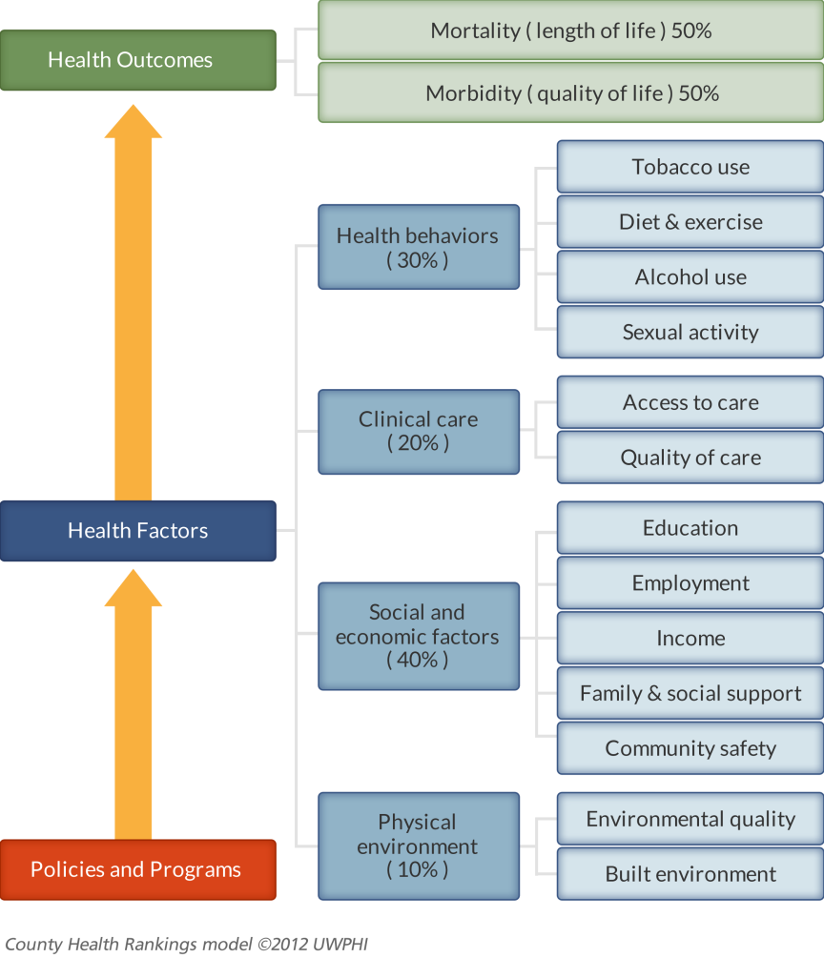
Coordinated Care Can Grow Supportive Housing
The 80/20 Rule
County Health Rankings show that much of what affects health occurs outside of the doctor’s office.
Physicians surveyed say:
Unmet social needs are directly leading to worse health.
The problems created by unmet social needs are problems for everyone.
50%

Slide 4
Medicaid Care Coordination: Quick Review
Integrated Care Program (ICP) Medicaid only and mandatory.
Medicare Medicaid Alignment Initiative (MMAI): Dual eligible. Medicare and Medicaid benefits under one MCO plan.
Innovation Projects: Provider organized
CCEs--non capitated payments
ACEs – three year path to full risk capitation
MCCNs---full risk capitation

Slide 5
 | Who | What | When
Managed Care Organizations | ACA adults, Family Health Plans (FamilyCare, All Kids, Moms & Babies) | Includes: PCP, Care Coordination, Some extra benefits Reimbursement: Capitated Payments Management and Enrollment: MCO, Mandatory Regions | On-going
Accountable Care Entities | ACA adults, Family Health Plans (FamilyCare, AllKids, Moms & Babies) | Includes: PCP, Care Coordination, Reimbursement: 3 year path to capitated payments Management and Enrollment: Provider Organized, Voluntary | 2014
Care Coordination Innovation Projects CCEs & MCCNs | SPD (AABD) Medicaid: CCEs MCCNs Children with Complex Medical Needs: CCEs ACA adults: CountyCare | Includes: PCP, Care Coordination, Some incorporate social services and housing, must link with behavioral health services Reimbursement: CCEs-FFS payments MCCNs-Capitated Payments Management and Enrollment: Provider Organized, Voluntary | CountyCare started 2012 – evolving to MCCN CCEs 2013 -on
MMAI: Medicare/Medicaid Alignment Initiative | SPD (AABD) Medicaid and Medicare Parts A and B No spend-down | Includes: PCP, Consumer Choice Options, Care Coordination, Reimbursement: Capitated Payments Management and Enrollment: MCOs, Semi-Mandatory (opt-out) | Started 2014 Transition: 60 days from letter to enroll, 180 day transition period to in-network providers, can change plans monthly unless receiving LTSS (locked in)
Integrated Care Program | SPD (AABD) Medicaid Only +Waiver Programs No Medicare No spend-down | Includes: PCP, Consumer Choice Options, Care Coordination Reimbursement: Capitated Payments Management and Enrollment: MCOs Mandatory | Started 2011 Rollout in Chicago 2014 Transition:60 days from initial letter to enroll, Can switch plans first 90 days, after 90 days locked in 12 months, 90 day transition to in-network providers

Slide 6
Care Coordination Expansion: Where it’s happening.
Link to map: http://www2.illinois.gov/hfs/SiteCollectionDocuments/CCExpansionMap.pdf
More great resources:
https://www2.illinois.gov/hfs/SiteCollectionDocuments/CCRollOutPlan.pdf
Notes:
STOP HERE: QUESTIONS
Link to map provided, as this is difficult to see.
Red is integrated care program.
Dark Blue is CCEs
Light blue is children with complex medical needs
Yellow in county care---this program has already been piloted, set to expire soon. Reimbursement at capitated rate per month rather than fee for service. Bought by centene corporation as MCCN.
Green---MMAI—Medicare Medicaid Alignment Initiative
Purple: Voluntary MCOs

Slide 7
DHS Grant-based
Medicaid -- Care Coordination
Medicaid – 1115
$30 million
Sustainability?
Revenue/business model?
Certification?
Accreditation?
Potential of “Stable Housing” payments
Revenue Sources for Supportive Housing Providers

Slide 8
Governor’s Office of Health Innovation and Transformation (GOHIT) Services & Supports Work Group

Slide 9
Profile – Services and Supports

Slide 10
GOHIT LTSS Subcommittee

Slide 11
What will this all mean for Supportive Housing Providers?
1115 Waiver has the potential to bring in additional dollars for supportive housing:
Mental Health Medicaid Rehab Option – Increase from $140 million to $180 million
Mental Health MCO – Increase from $40 million to $80 million
Stable Housing - $60 million

Slide 12
How to engage and participate in the GOHIT process?
Go to:
http://www2.illinois.gov/gov/healthcarereform/Pages/AllianceWorkGroups.aspx
Look for updates from SHPA on meeting dates
Stay connected through this process today

Slide 13
Opportunities for Supportive Housing Providers Moving Forward
Connect Managed Provider in your service area
Understand how the population you serve is getting coverage
Stay abreast of new funding opportunities (ie the 1115 waiver)
Evaluate your business model to ensure you are poised to take advantage of any and all opportunities.

